Slide 1

Unsupervised Learning (K-Means Clustering)
ALDY BUDHI ISKANDAR #DataScienceEnthusiast
aldybudhi003@gmail.com
https://www.linkedin.com/in/aldybudhi/
https://github.com/qodym

Slide 2
Data Understanding
Data Understanding
DESCRIPTIVE STATISTICS
MATRIX CORRELATION
DESCRIPTIVE STATISTICS
MATRIX CORRELATION

Slide 3
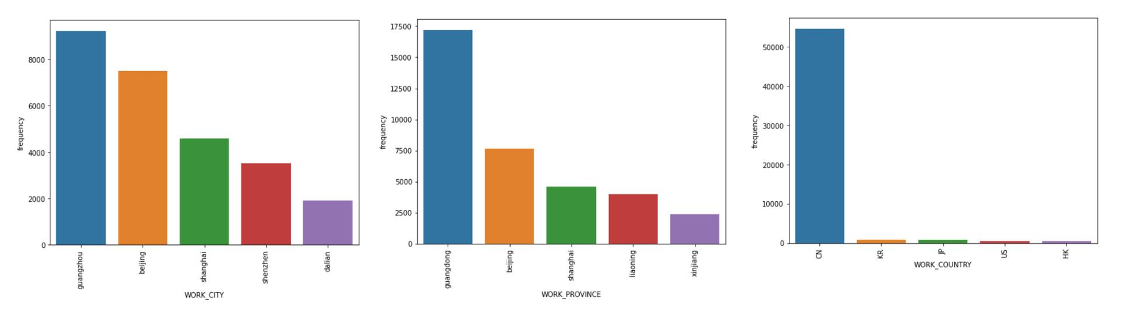
Descriptive Statistics
Top categorical data:
Based on gender is Male customer.
Based on customers domicile is comes from Guangzhou, Province of Guangdong, China.
aldybudhi003gmail.com https://github.com/qodym https://www.linkedin.com/in/aldybudhi/

Slide 4
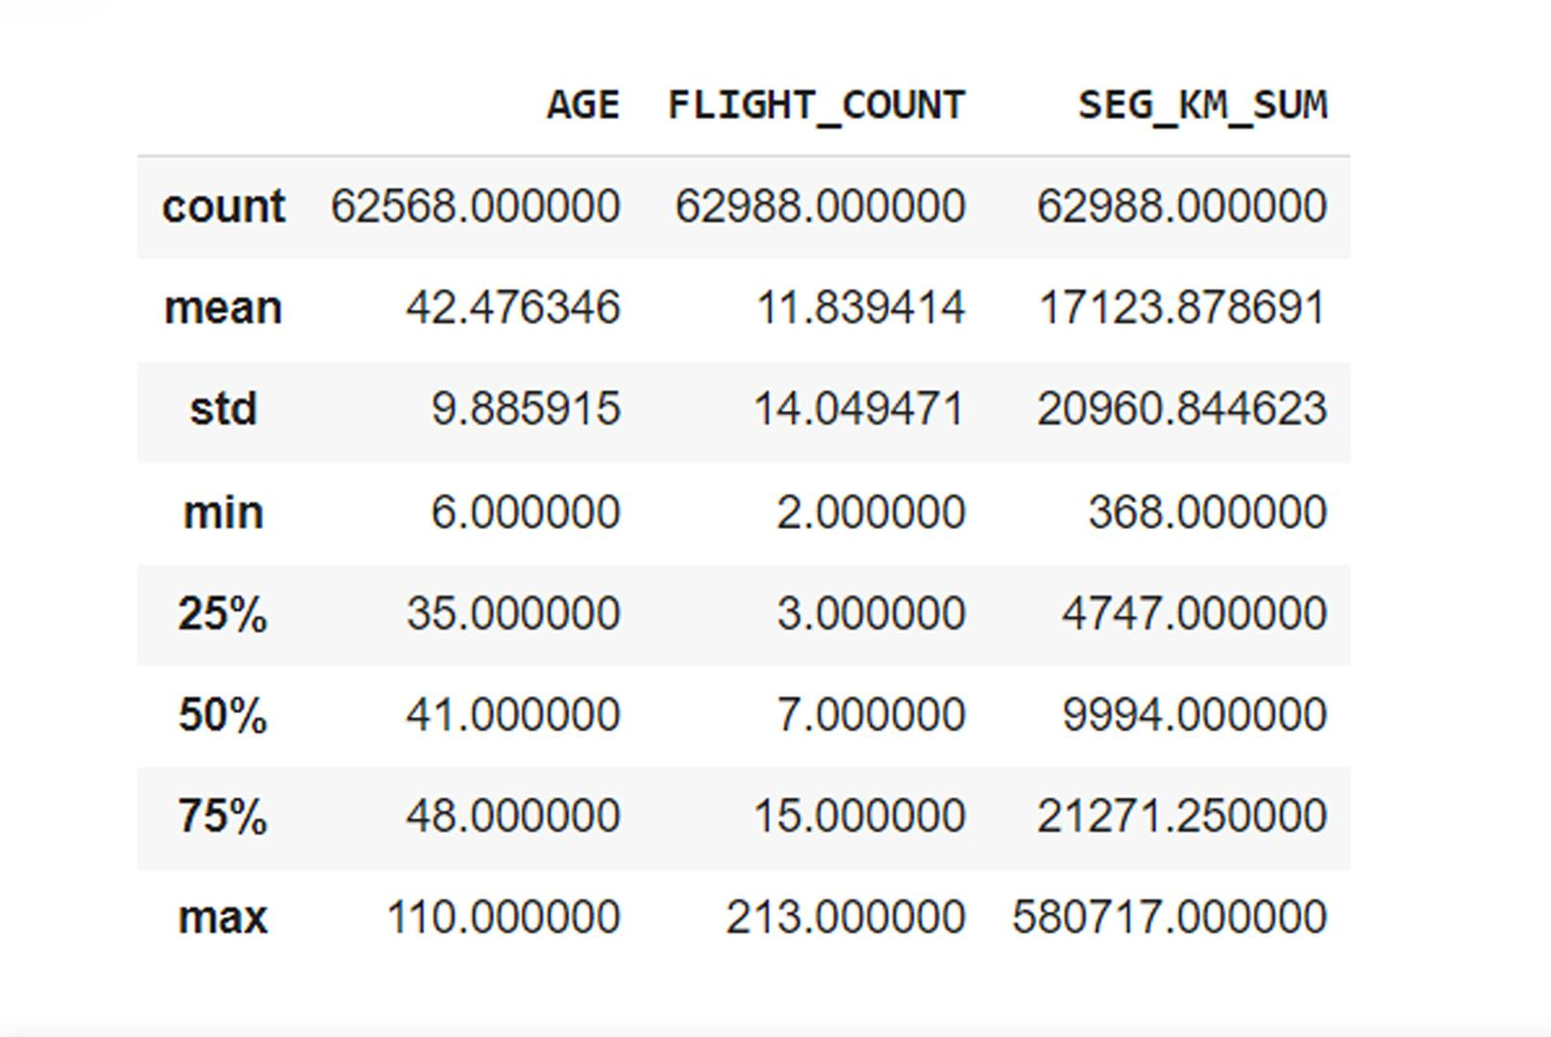
Descriptive Statistics
Top numerical data:
The median age of customers is 41 years.
The median total flight per customer is 7 flights.
The median total distance covered is 9994 Km.
Median is the middle value of the data.
aldybudhi003gmail.com https://github.com/qodym https://www.linkedin.com/in/aldybudhi/

Slide 5
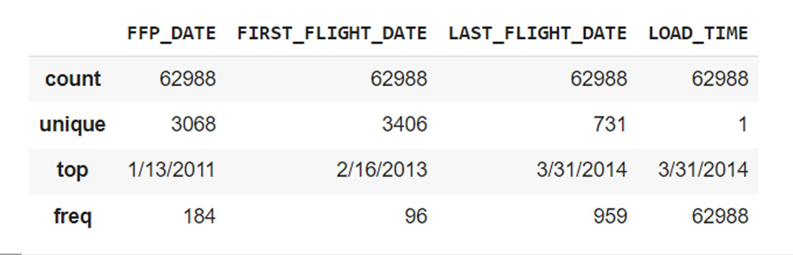
Descriptive Statistics
Top datetime data:
Most customers join date, which is on January 13, 2011.
The first flight with the most customers on February 16, 2013.
Top frequent value
aldybudhi003gmail.com https://github.com/qodym https://www.linkedin.com/in/aldybudhi/

Slide 6
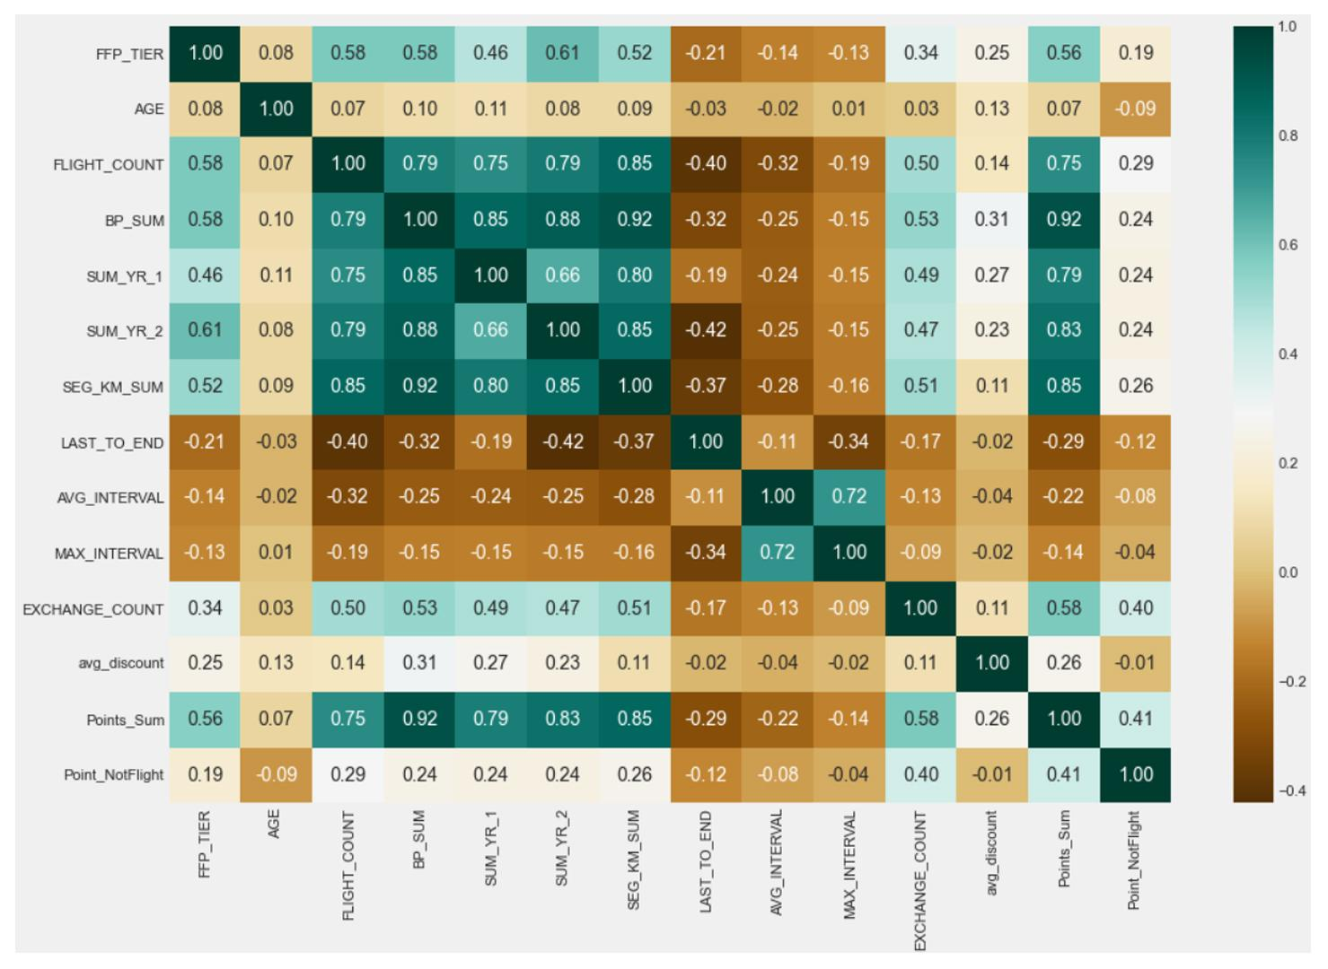
Matrix Correlation
There are features that have a high correlation with other features, including:
FLIGHT_COUNT
BP_SUM
SUM_YR_1
SUM_YR_2
SEG_KM_SUM
Points_Sum
aldybudhi003gmail.com https://github.com/qodym https://www.linkedin.com/in/aldybudhi/

Slide 7
Data Understanding
Data Preparation
DESCRIPTIVE STATISTICS
MATRIX CORRELATION
MISSING VALUE
LRMFC FEATURE

Slide 8
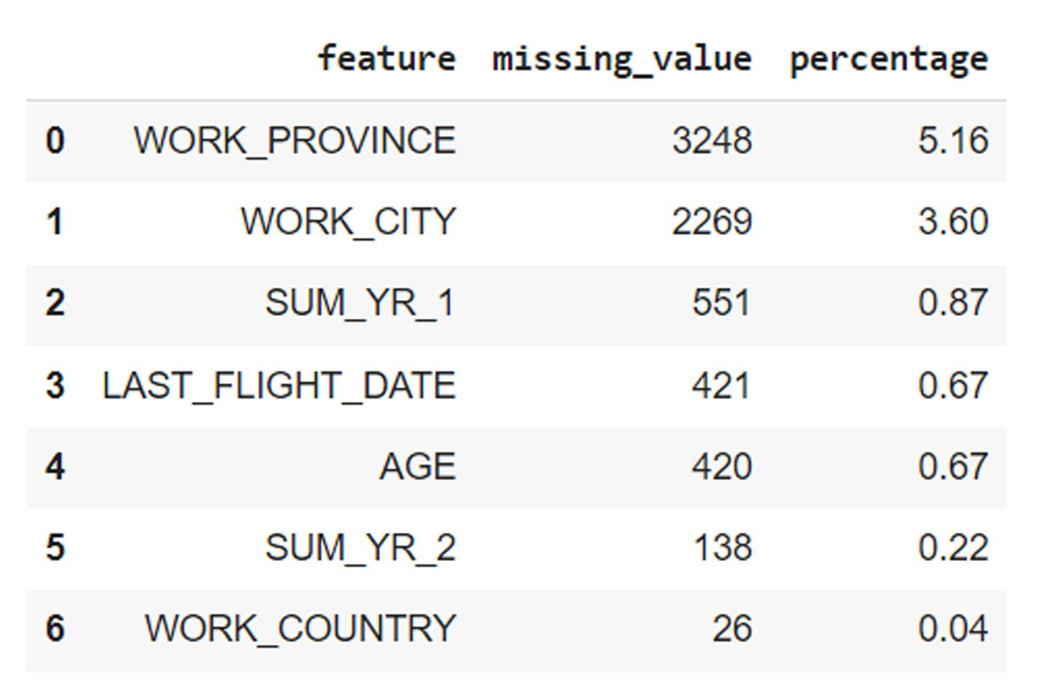
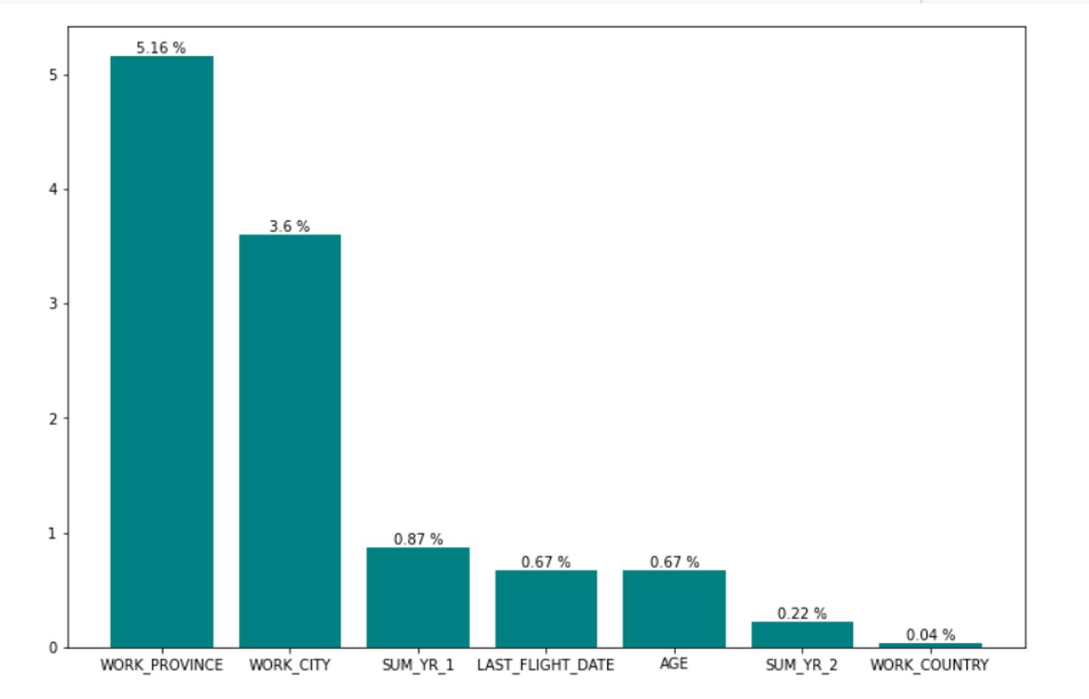
Missing Value
Delete rows that have missing values
Because of the small number of missing values.
aldybudhi003gmail.com https://github.com/qodym https://www.linkedin.com/in/aldybudhi/

Slide 9
LRMFC Feature
* L (Length Relation) = `LOAD_TIME` - `FFP_DATE` The number of months since the member ’s membership time from the end of the observation window = end time of the observation window-time to join (unit: month).
* R (Recency) = `LAST_TO_END` The number of months since the customer ’s most recent flight to the end of the observation window = the time from the last flight to the end of the observation window (Unit: month).
* F (Frequency) = `FLIGHT_COUNT` The number of times the customer took the company aircraft in the observation window = the number of flights in the observation window (unit: times].
* M (Monetary Value) = `SEG_KM_SUM` The accumulated mileage of the customer in the company during the observation period = the total number of flight kilometers in the observation window (unit: km).
* C (Coefficient Value) = `AVG_DISCOUNT` The average value of the discount coefficients corresponding to the passengers who traveled during the observation period = average discount rate (unit: none).
aldybudhi003gmail.com https://github.com/qodym https://www.linkedin.com/in/aldybudhi/

Slide 10
Data Understanding
Outlier Handling
DESCRIPTIVE STATISTICS
MATRIX CORRELATION
DATA DISTRIBUTION
DUPLICATE DATA
SCALING

Slide 11
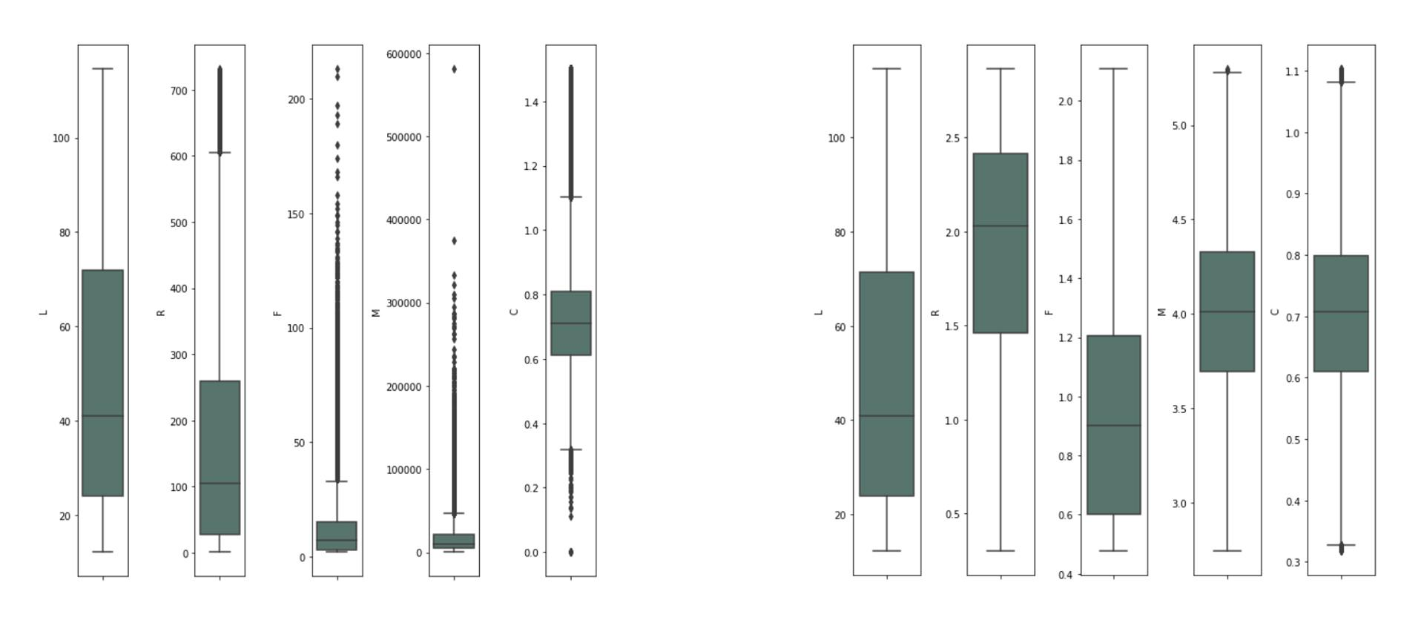
Data Distribution
There are outliers in numerical data, and it has a skewed distribution.
Implementation of log transformation reduces outliers and removes based on IQR on the data, and it has a distribution that is close to normal.
aldybudhi003gmail.com https://github.com/qodym https://www.linkedin.com/in/aldybudhi/

Slide 12
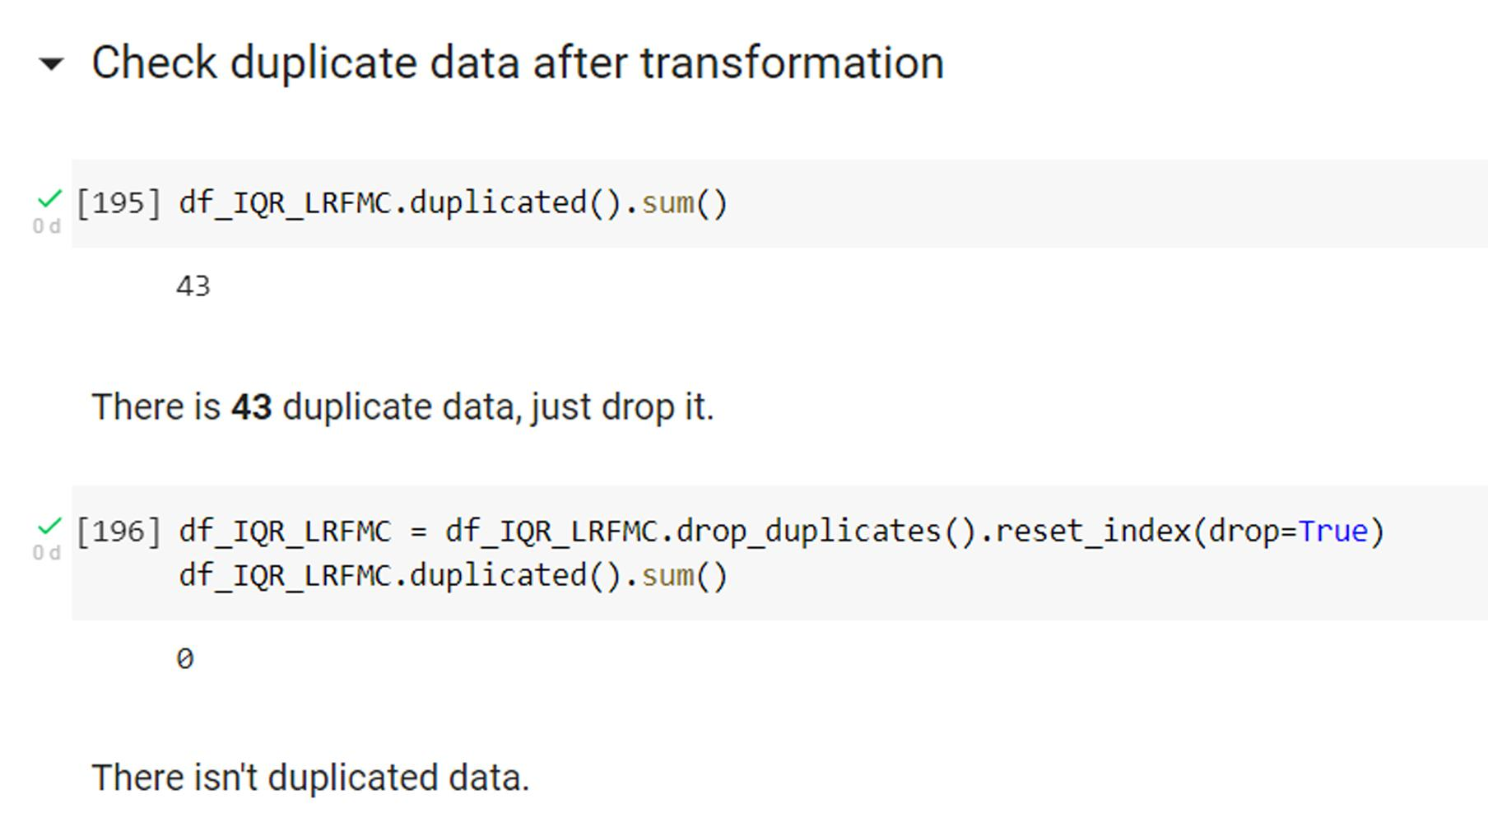
Duplicate Value
There are 43 duplicate values with the LMRFC feature, in this case all duplicate values are deleted.
aldybudhi003gmail.com https://github.com/qodym https://www.linkedin.com/in/aldybudhi/

Slide 13
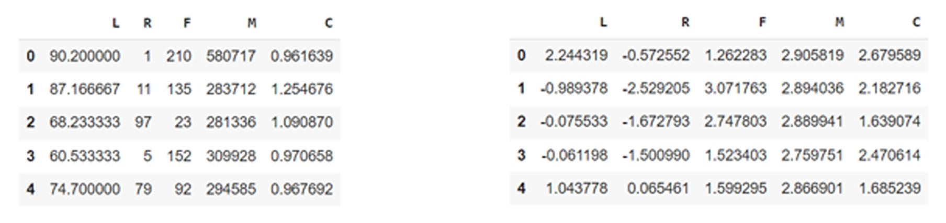
Scaling
In this case the scaling uses the StandardScaler method.
Before scaling
After scaling
aldybudhi003gmail.com https://github.com/qodym https://www.linkedin.com/in/aldybudhi/

Slide 14
Data Understanding
Modeling
K-Means Clustering
DESCRIPTIVE STATISTICS
MATRIX CORRELATION
CLUSTERING

Slide 15
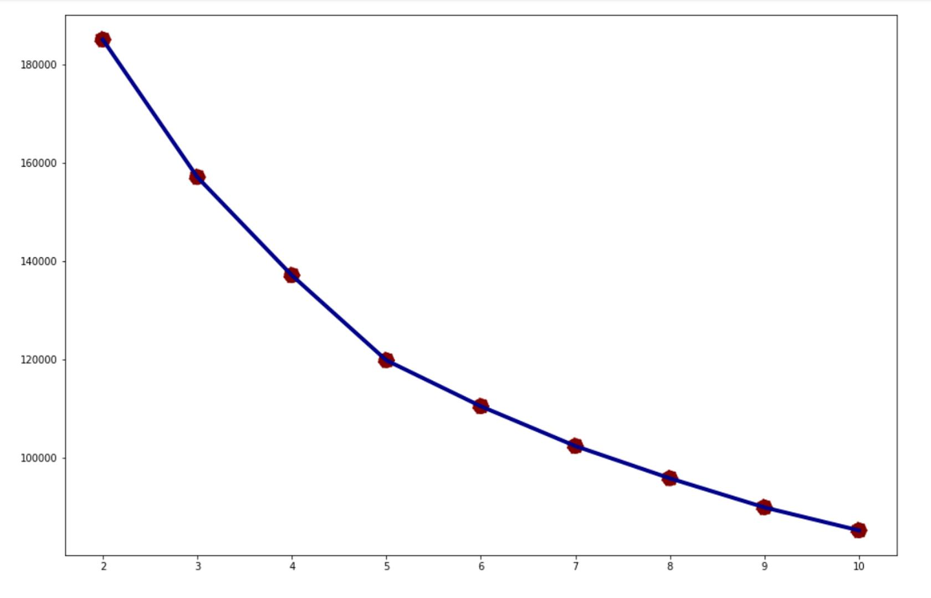
Clustering (Elbow Method)
Elbow Method
The value of each point in the elbow method has almost the same terms, from this graph the best candidates is point K = 5.
To make sure the K value, lets try again using Silhouette Score method.
aldybudhi003gmail.com https://github.com/qodym https://www.linkedin.com/in/aldybudhi/

Slide 16
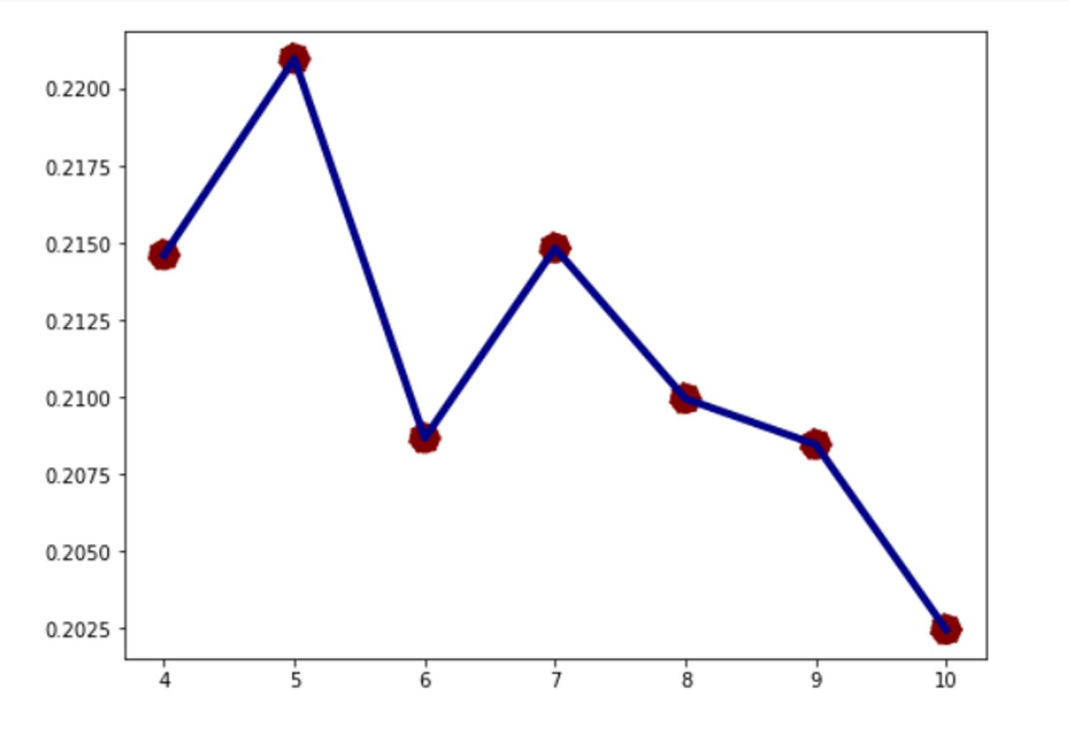
Clustering (Silhouette Score)
Silhouette Score Method
The value K = 5 is the right choice for KMC (K-Means Clustering).
aldybudhi003gmail.com https://github.com/qodym https://www.linkedin.com/in/aldybudhi/

Slide 17
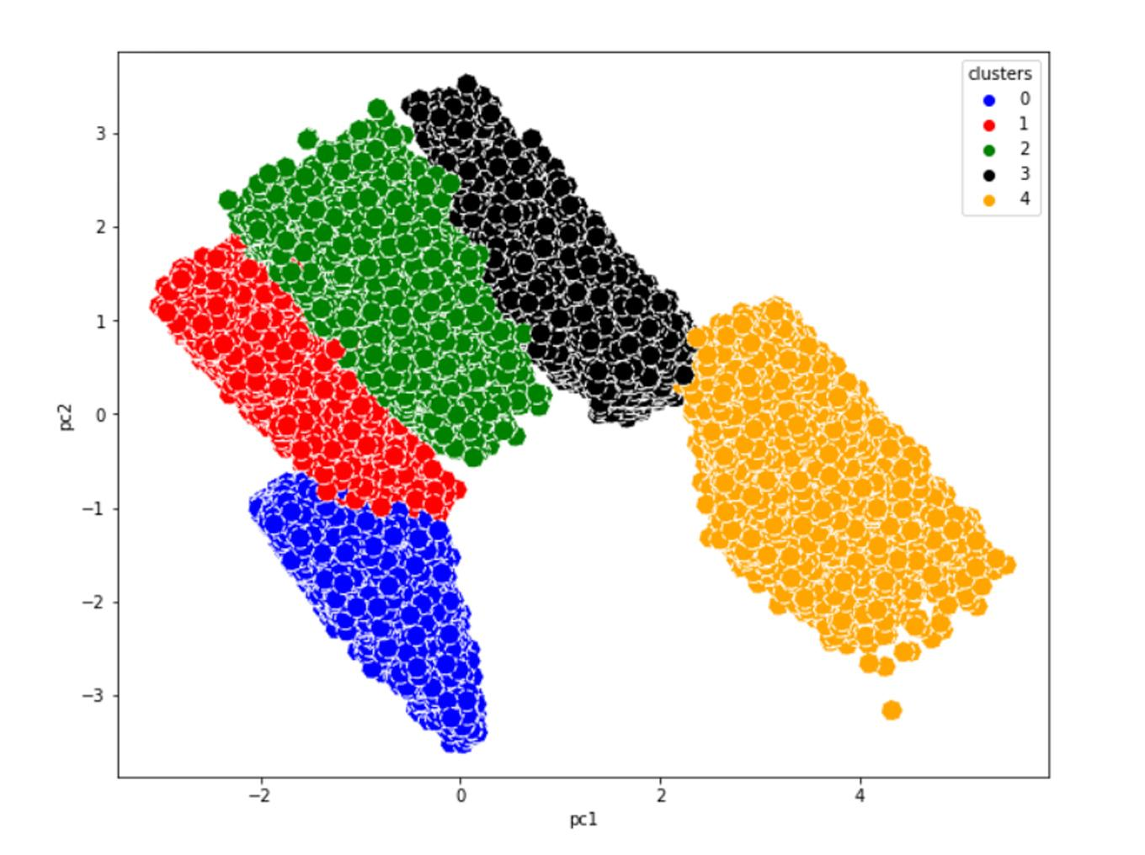
Clustering (Scatter Plot)
Scatter Plot
When compared with clustering visualization with PCA, then the value of K = 5 is the right number of clusters.
aldybudhi003gmail.com https://github.com/qodym https://www.linkedin.com/in/aldybudhi/

Slide 18
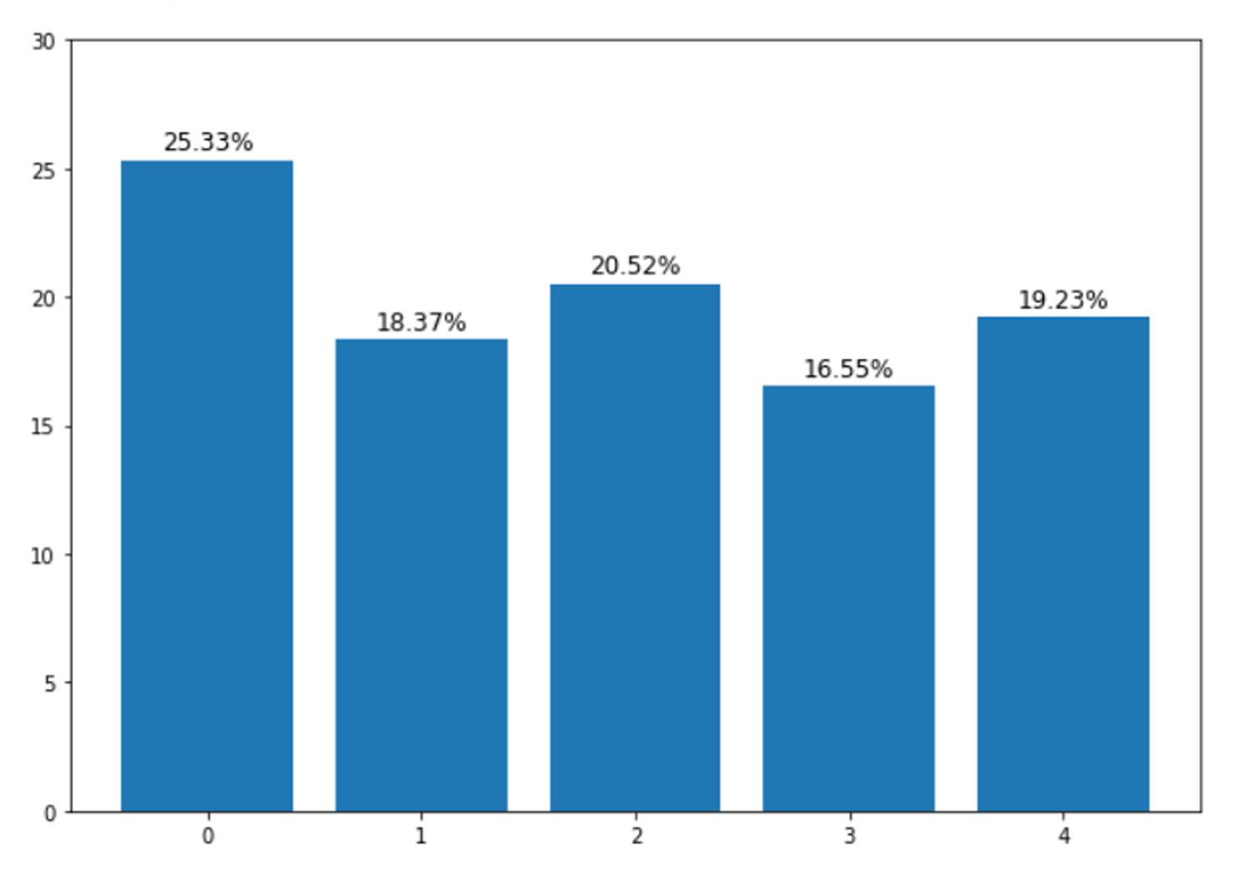
Clustering (Bar Plot)
There are 5 clusters:
Cluster 0 -> 25.33%
Cluster 1 -> 18.37%
Cluster 2 -> 20.52%
Cluster 3 -> 16.55%
Cluster 4 -> 19.23%
aldybudhi003gmail.com https://github.com/qodym https://www.linkedin.com/in/aldybudhi/

Slide 19
Data Understanding
Clustering Analysis
DESCRIPTIVE STATISTICS
MATRIX CORRELATION
CHARACTERISTIC CLUSTER
CONCLUSION

Slide 20
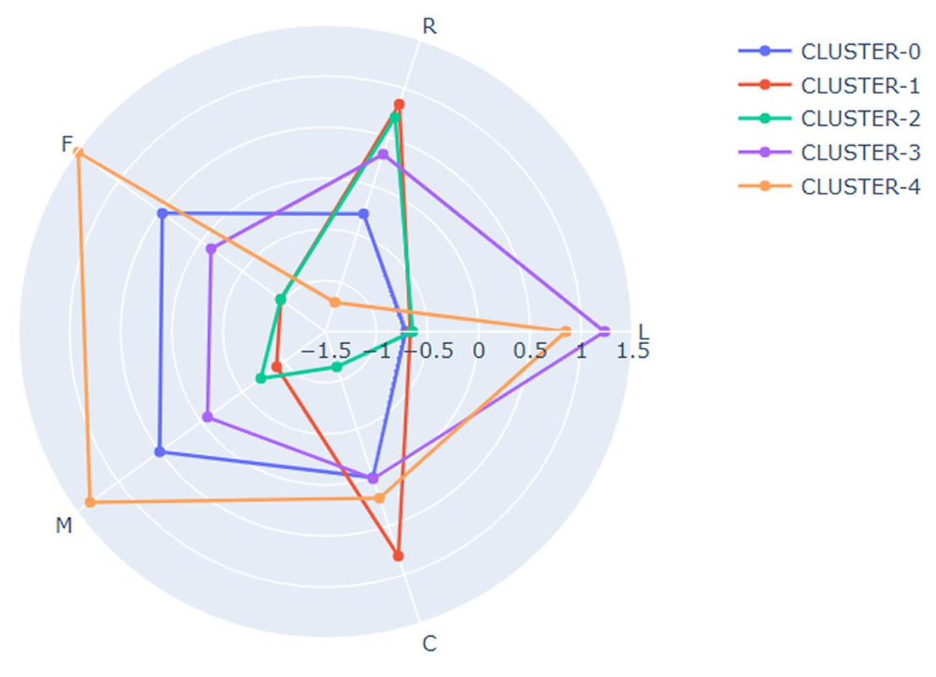
Clustering Characteristic
Cluster 0 = Customer Group 1
Cluster 1 = Customer Group 2
Cluster 2 = Customer Group 3
Cluster 3 = Customer Group 4
Cluster 4 = Customer Group 5
In general, cluster users are formed because there are users who have high / low scores on the LRMFC feature.
aldybudhi003gmail.com https://github.com/qodym https://www.linkedin.com/in/aldybudhi/

Slide 21
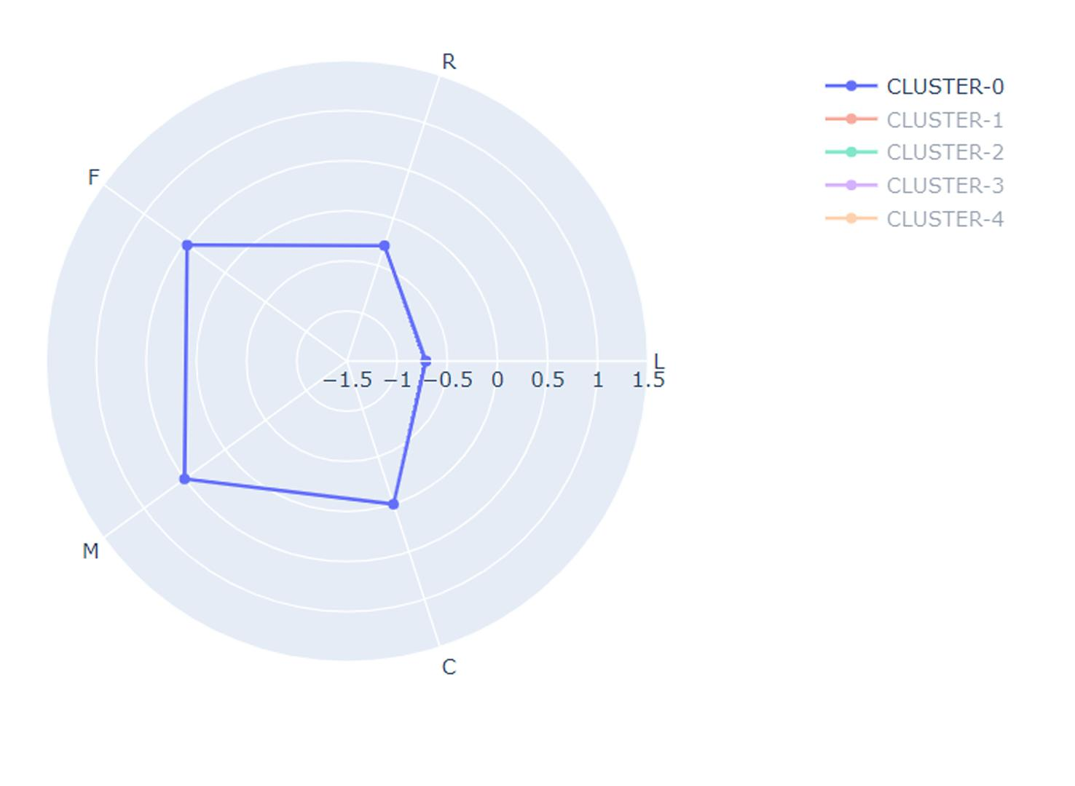
Characteristic - Cluster 0
Cluster 0 (Customer Group 1)
Is a new user, because it has a low value on feature L, and can be assumed to be a new user.
New user but has a relatively large number of flights so that it is high on F and M features.
Feature C is quite high, it can be assumed that it is a user who occasionally makes flights because of the promo.
aldybudhi003gmail.com https://github.com/qodym https://www.linkedin.com/in/aldybudhi/

Slide 22
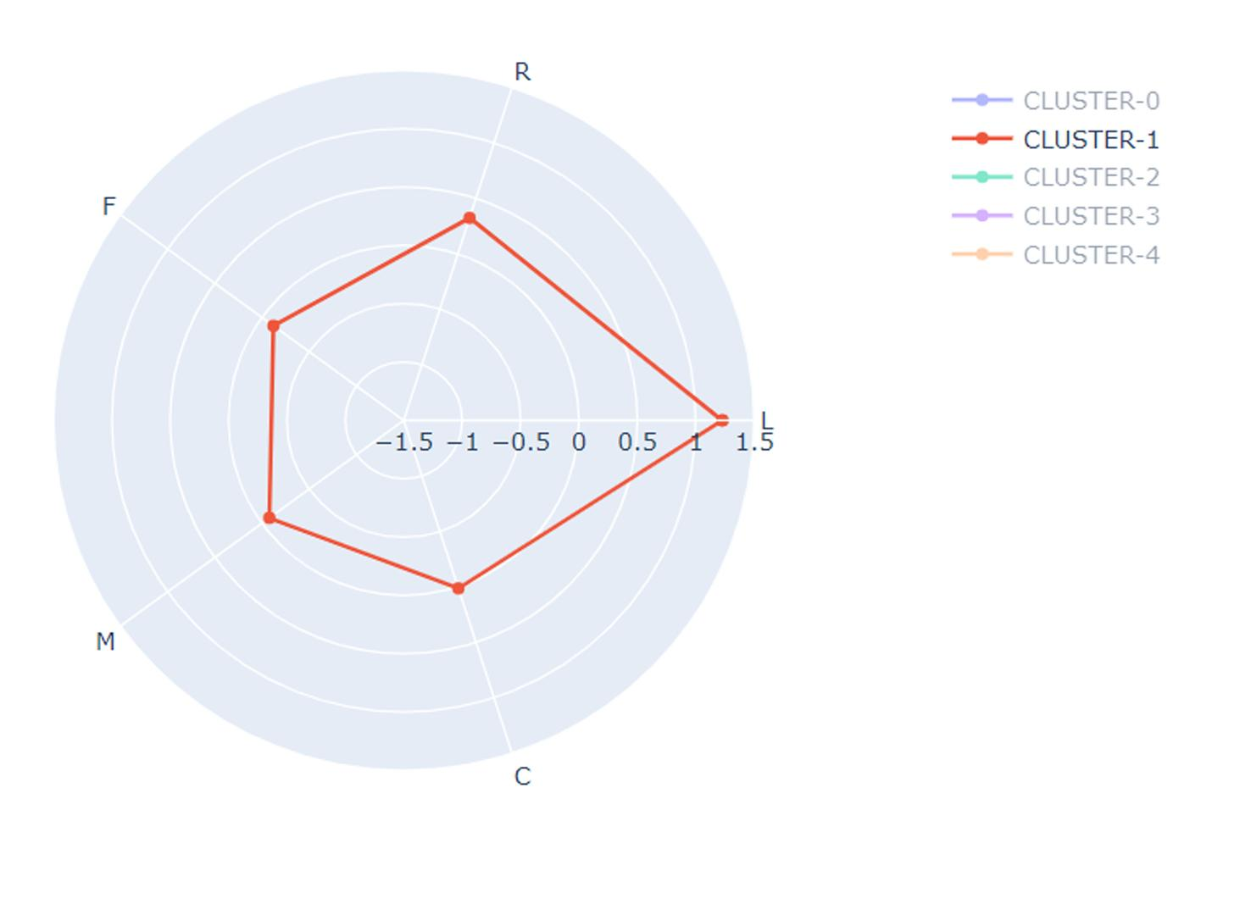
Characteristic - Cluster 1
Cluster 1 (Customer Group 2)
This users have LRMFC values that are almost in every feature.
It can be assumed that old users often fly and are promo hunters, because they have a high C value.
aldybudhi003gmail.com https://github.com/qodym https://www.linkedin.com/in/aldybudhi/

Slide 23
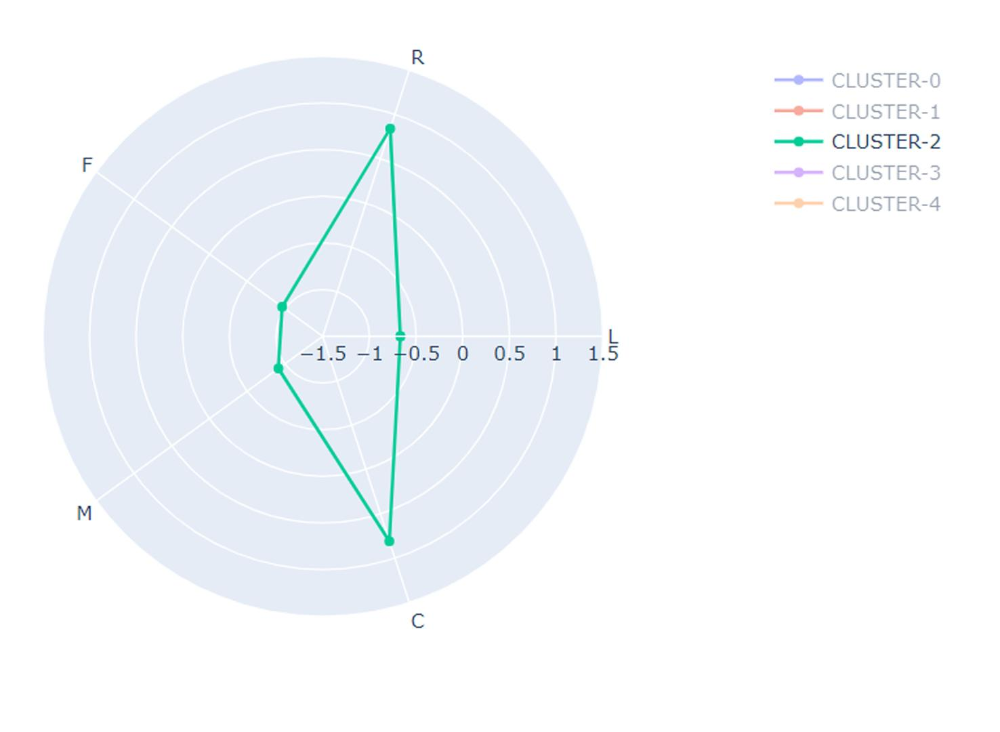
Characteristic - Cluster 2
Cluster 2 (Customer Group 3)
Is a new user, because it has a low value on feature L, and can be assumed to be a new user.
New user and has very few flights so very low against F and M features.
but the value of C is quite high, meaning users who rarely fly but are very interested in the promo, this is what makes the C value very high.
aldybudhi003gmail.com https://github.com/qodym https://www.linkedin.com/in/aldybudhi/

Slide 24
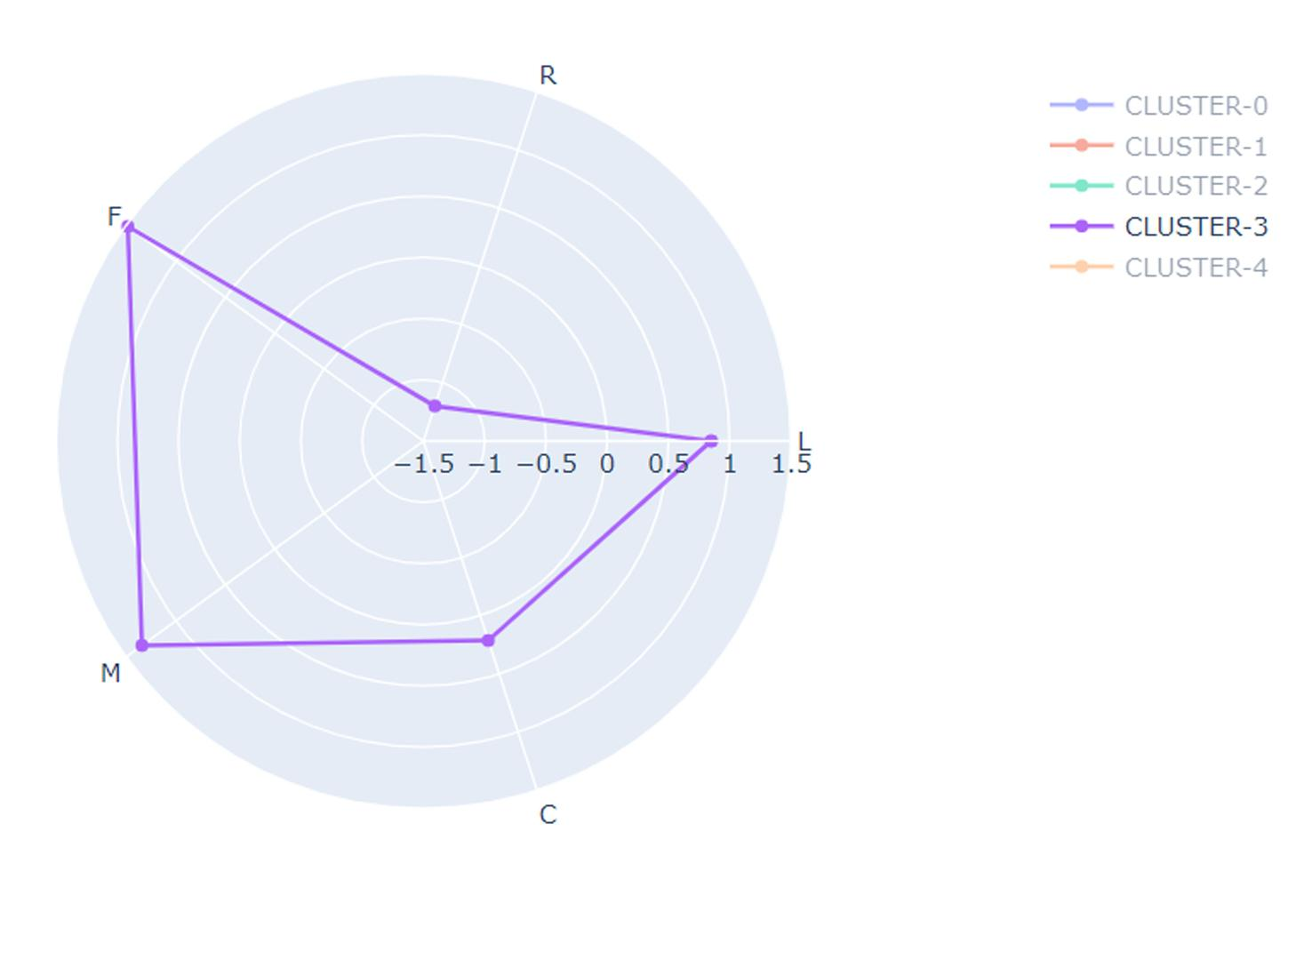
Characteristic - Cluster 3
Cluster 3 (Customer Group 4)
Is an user who has been registered for a long time, because it has a high value on the L feature and can be assumed to be an old user.
Old users and have a large number of flights so high on F and M features.
It can be assumed that this user often makes flights and is a loyal customer who sometimes uses promos.
aldybudhi003gmail.com https://github.com/qodym https://www.linkedin.com/in/aldybudhi/

Slide 25
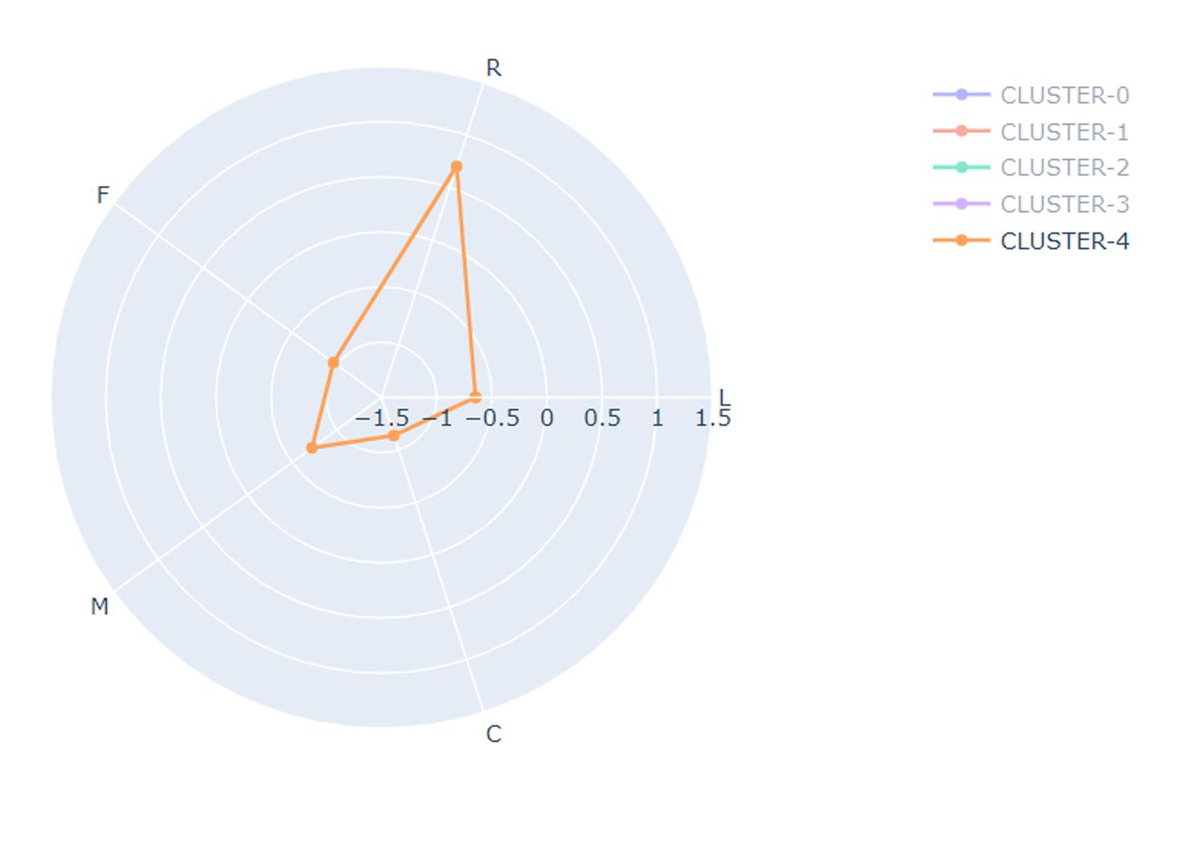
Characteristic - Cluster 4
Cluster 4 (Customer Group 5)
Is a new user, because it has a low value on feature L, and can be assumed to be a new user.
New user and rarely do flights so low on F and M features.
With a low C feature value, it can be assumed that this user is not interested in the promo.
aldybudhi003gmail.com https://github.com/qodym https://www.linkedin.com/in/aldybudhi/

Slide 26
Conclusion:
Customer Group 1 -> New user but has a relatively large number of flights.
Customer Group 2 -> Old users often fly and are promo hunters.
Customer Group 3 -> New user and has very few flights, rarely fly but are very interested in the promo.
Customer Group 4 -> Old users and have a large number of flights.
Customer Group 5 -> New user and rarely do flights & not interested in the promo.
Let's Check out my python code Jupyter notebook !!! Don't hesitate to contact me if you want to do some correction or discussion !
#DataScience #ClusteringModelling #DataCleansing #OutlierHandling
aldybudhi003gmail.com https://github.com/qodym https://www.linkedin.com/in/aldybudhi/

